Slide 1

Space Shooter – Episode 03
Notes:
In this presentation we’ll add more elements to our Space Shooter game.

Slide 2
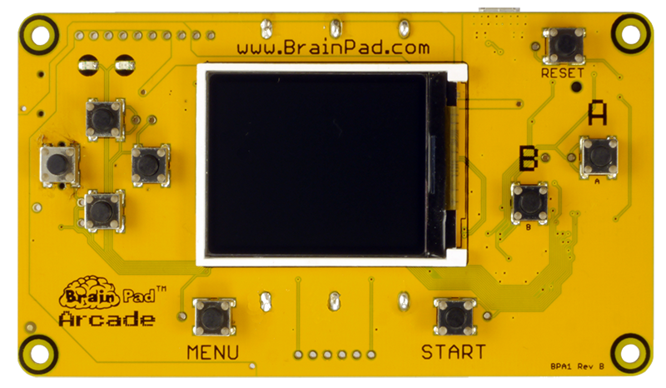
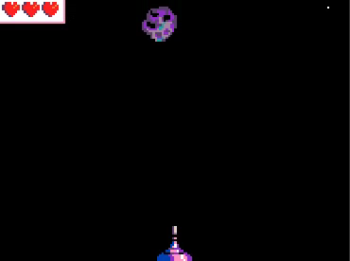
Let’s add scoring, lives, and effects to our game.
Notes:
Let’s add scoring, lives and effects to our game.

Slide 3
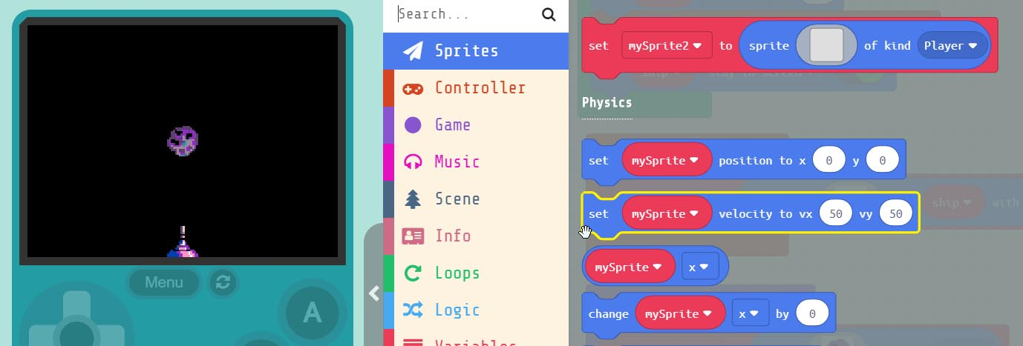
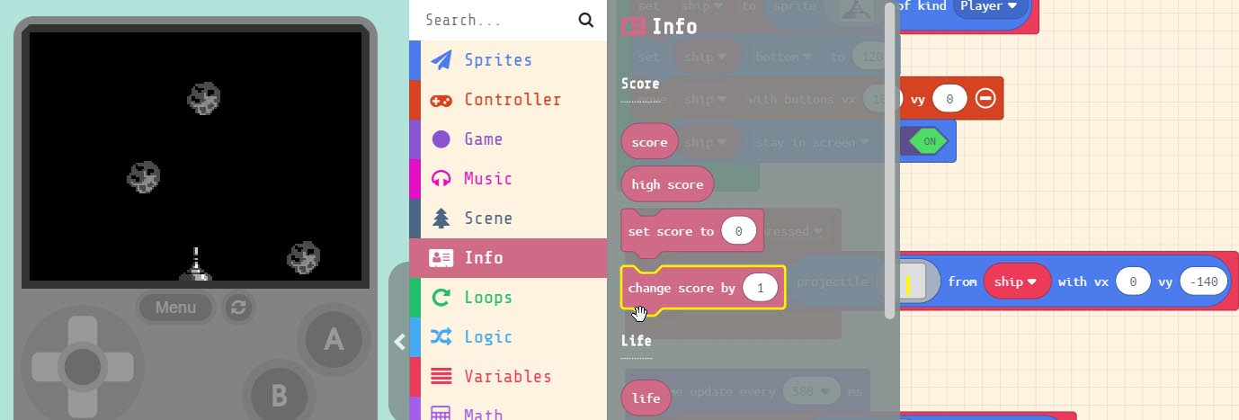

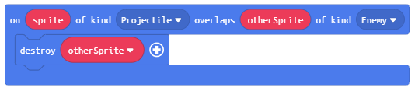
Grab the block.
Add to the inside our work area
Notes:
Let’s add some scoring to the game. So every time we destroy an ‘asteroid’, we get a point. Grab the ‘change score by 1’ block. It can be found under ‘Info’ in the menu. Drag this into our ‘overlap event’ that destroys the ‘asteroid’ when it’s hit by our bullet.

Slide 4
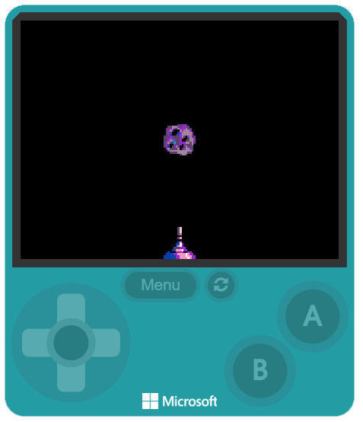
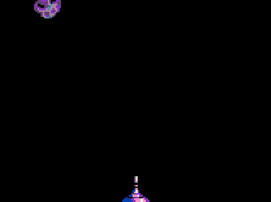
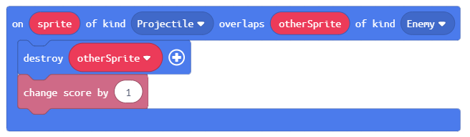
Now when we destroy an
‘asteroid’ we get a point.
We almost have a game!!
We need to add some risk
to our ‘ship’ to make it fun.
Notes:
Now every time we shoot an ‘asteroid’ we get a point. We almost have a game! We need to add some risk to the player. We need to create an overlap event, for when an ‘asteroid’ hits our ‘ship’.

Slide 5
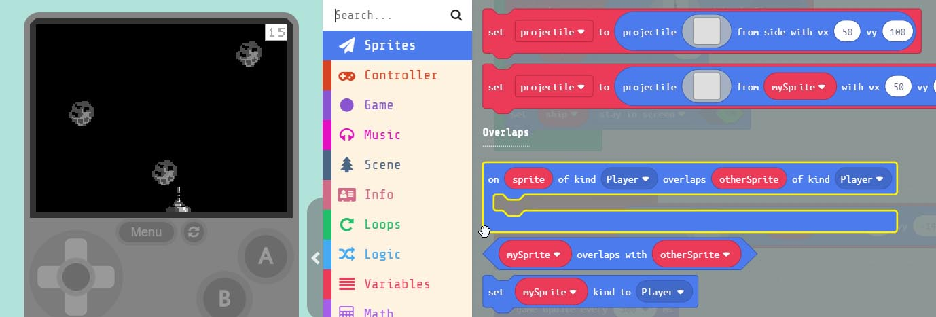
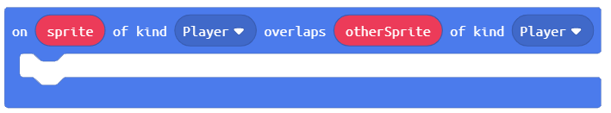
Grab the block.
This is the same event block we used to detect the overlap
between our ‘bullet’ and an ‘asteroid’.
Notes:
Let’s add collision detection between our player ‘ship’ and an ‘asteroid’. This will make our game more challenging. First we need to grab an ‘on sprite of kind Player overlaps otherSprite’ block. This is the same block we used to detect an overlap between our ‘bullet’ and an ‘asteroid’.

Slide 6
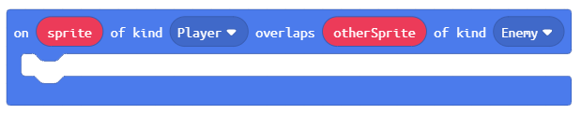
We need to change the last
parameter to ‘Enemy’
Now whenever an ‘asteroid’
overlaps with our ‘ship’
the code we put in this
event block will run.
Notes:
We need to change the last parameter to ‘Enemy’. Now when ever our ‘ship’ overlaps with an ‘asteroid’ what ever code block we put in this event block will run in our program.

Slide 7
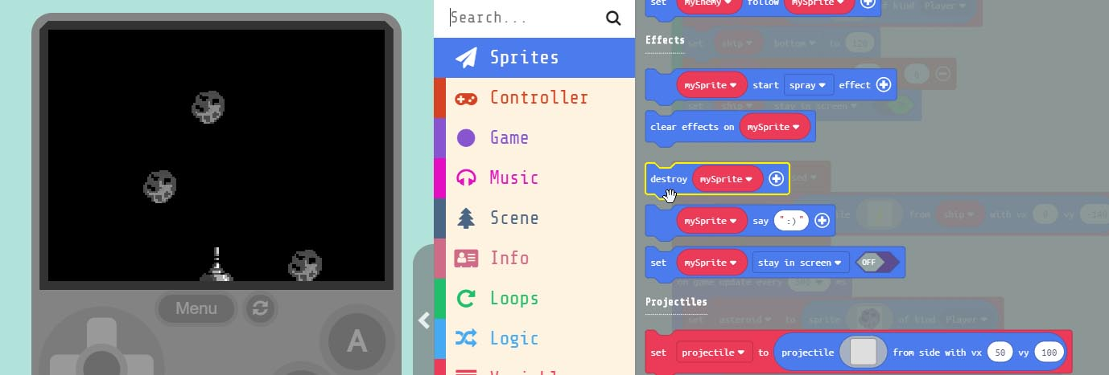

Grab the block,
and drag it into the event block.
Notes:
Grab the ‘destroy mySprite’ block and drag it into the event block we just added. Keep in mind there are now 2 overlap ‘event’ blocks in our program now. One that destroys the ‘asteroid’ when it’s hit with a ‘bullet’ and the new one we just added.

Slide 8
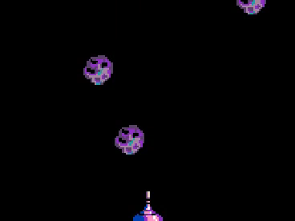
We need to change the name
to ‘otherSprite’
This may seem odd at first,
why aren’t we destroying the
‘ship’ instead?
If we selected to destroy the ‘ship’
it would disappear and the game
would be over. We need to add lives!!!
Notes:
We need to change the parameter in the block to destroy the ‘otherSprite” which is the ‘asteroid’ in this case. This may seem odd at first. Why wouldn’t we destroy the ‘ship’ instead? If we selected to destroy the ship instead it would disappear, and the game would be over.

Slide 9
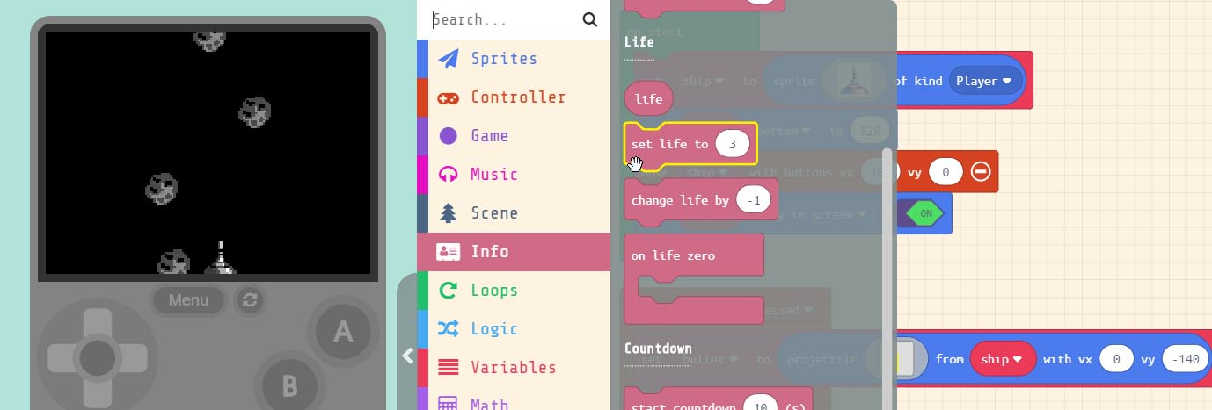

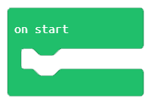
Grab the block.
Drag it into the block. Which is in the work area.
Notes:
Grab the ‘set life to 3’ block. You can find it under ‘Info’ in the menu. Drag it into the ‘on start’ block. You can put it anywhere inside the block.

Slide 10
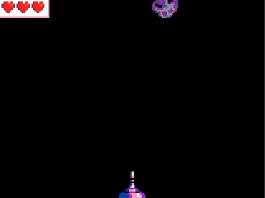
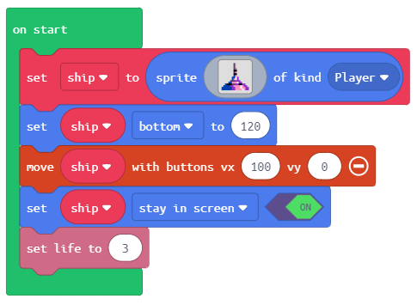
This is only the first step.
You may notice that when the
‘asteroid’ hits the ship now
our lives still don’t change.
Notes:
This is only the first step. You may have noticed that when the ‘asteroid’ hits the ‘ship’ nothing happens. That’s because we only created the lives. We need to take away a life every time the ‘asteroid’ hits our ‘ship’. Where do you think we would add the block that takes away a life?

Slide 11
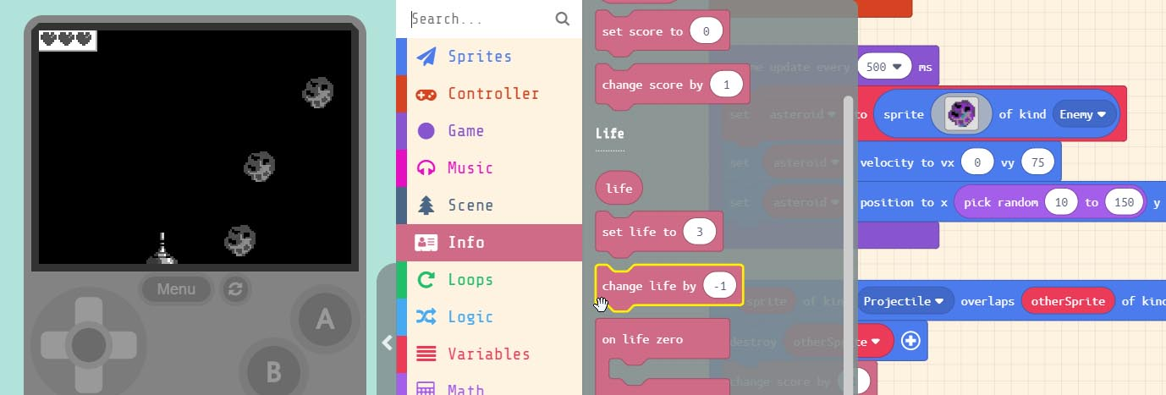

Grab the block.
Drag it into the block.
Notes:
Grab the ‘change life by -1’ block. You can find it under ‘Info’ in the menu. Drag it into the ‘on sprite of kind Player overlaps otherSprite of kind Enemy’ block.

Slide 12
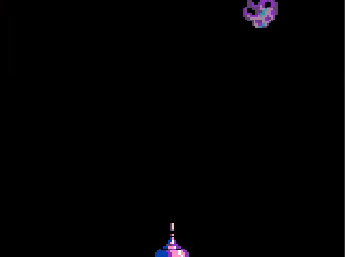
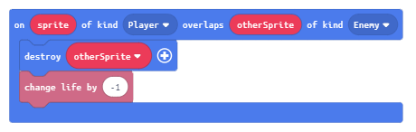
DO NOT confuse the two
overlap blocks in our project.
Now when the ‘ship’ overlaps
an 'asteroid' our lives with decrease
Notes:
DO NOT confuse this with the other overlap block in our project. Which looks for overlaps between a ‘Projectile’ and an ‘Enemy’. We want the one that checks for overlap between the ‘Player’ and an ‘Enemy’. We now have the elements of a complete game. Let’s add some effects to make it COOL!!

Slide 13
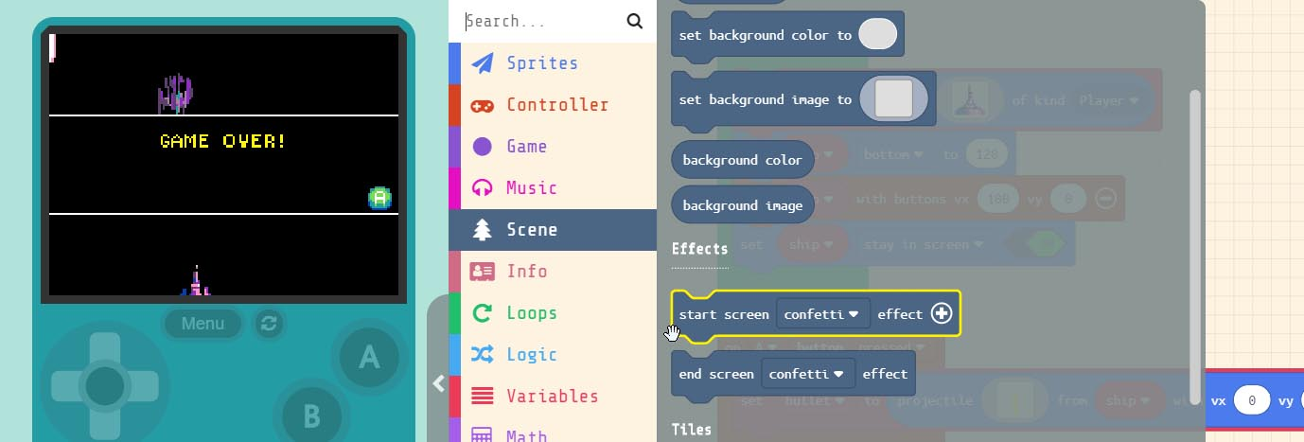

Grab the block.
Drag it into the block
Notes:
Grab the ‘start screen confetti effect’ block. You can find it under ‘Scene’ in the menu. Drag it into the ‘on start’ block.

Slide 14
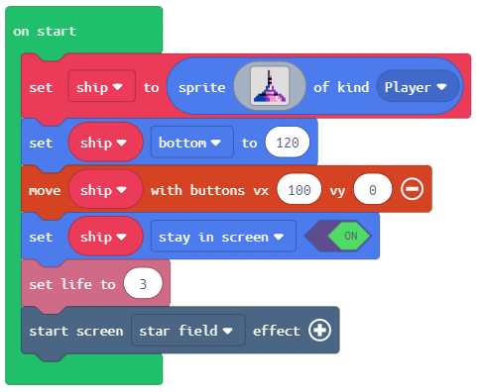
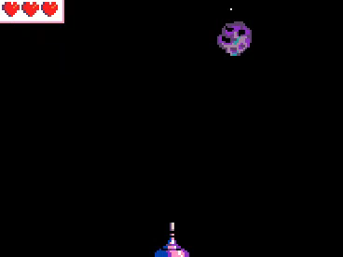
Change the parameter in the
block to ‘star field’.
Now when our game starts,
a star field background is generated.
Notes:
Change the parameter in the block to ‘star field’ by clicking on the down arrow. Now when our game starts a star field background is generated. This simple effects makes our game feel like we’re flying through space. Let’s add another EFFECT to the game.

Slide 15
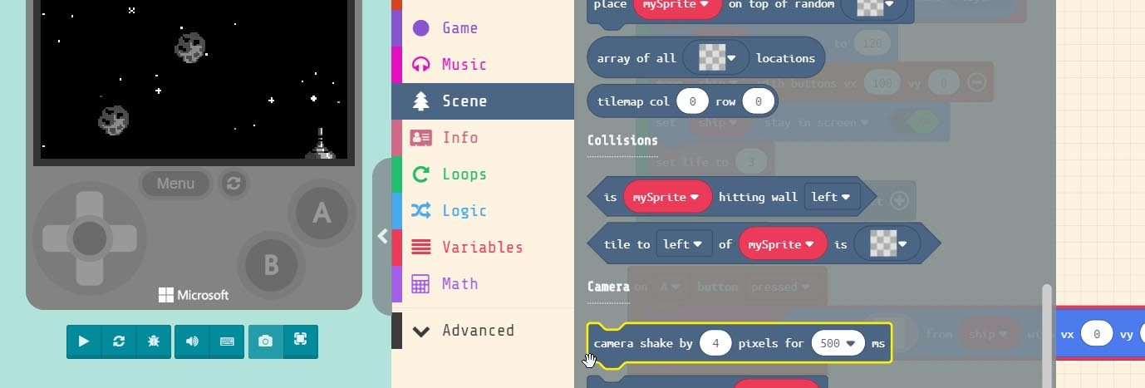

Grab the block.
Drag it into the overlap block
Notes:
Let's shake the camera when ever an ‘asteroid’ hits our ‘ship’. To do this we need to grab the ‘camera shake by 4 pixels for 500 ms’ block. Drag this into the ‘Player’ overlaps ‘Enemy’ block. Remember we have two overlap blocks, make sure you put it in the right one.

Slide 16
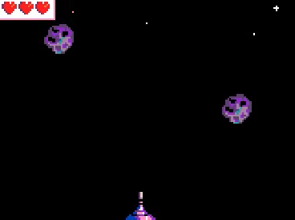
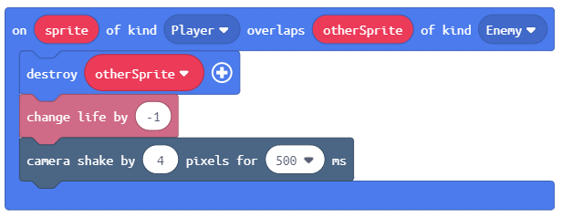
Now when an ‘asteroid’ hits our ‘ship’
the screen shakes. This adds more
realism to our game.
Let’s add one more effect. This one
doesn’t require adding a block.
Notes:
Now when an ‘asteroid’ hits our ‘ship’ the screen shakes. This adds more realism to our game. Let’s add one more effect to our game. The next effect doesn’t require us adding a block but changing a parameter in one of the blocks we already added.

Slide 17
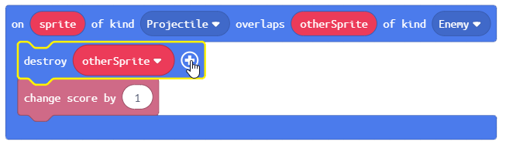
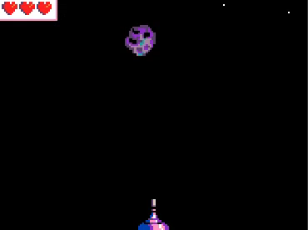
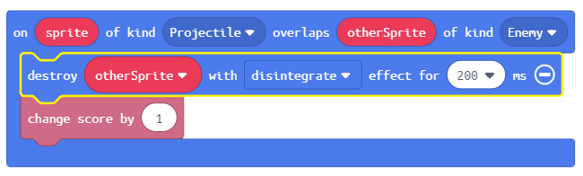
If we click on the ‘+’ inside
the overlap event that destroys
an ‘Enemy’ with a ‘Projectile’
then our ‘asteroid’ will blowup
when hit by our ‘bullet’
Notes:
If we click on the ‘+’ inside the overlap event that destroys an ‘Enemy’ with a ‘Projectile’ then our ‘asteroid’ will blowup when hit by our ‘bullet’

Slide 18
Hardware Break
Now let’s load our complete game on the BrainPad.
Notes:
Now let’s load our complete game onto the BrainPad.
**If more time is available, students can change elements in the game turning the ‘asteroids’ into falling ducks. Or drawing their own ship in the ‘Sprite’ editor. The sky is the limit here, so have FUN!!!**

Slide 19
EXTRA
CREDIT
Notes:
Now let’s load what we have so far on the BrainPad.

Slide 20


Code to Blocks:
JavaScript:
Block:

Slide 21
Code to Blocks:
JavaScript:
Block:

Slide 22
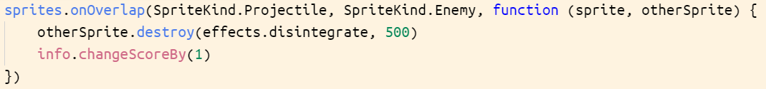
Code to Blocks:
JavaScript:
Block:

Slide 23
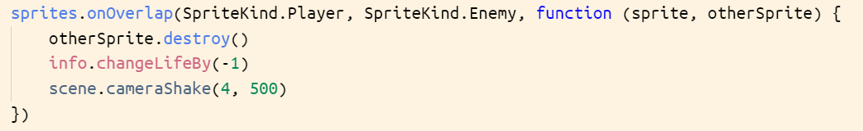
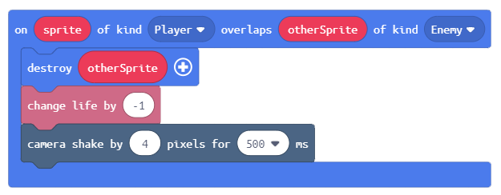
Code to Blocks:
JavaScript:
Block:

